Slide 1

BANK CUSTOMER
CHURN
By Soane Mota
April 18, 2019

Slide 2


CHALLENGE DESCRIPTION
Develop a model to help identify which customers are at risk to discontinue their services with a bank.
Use a provided data set that contains details of a bank's customers and the target variable is a binary variable reflecting the fact whether or not the customer left the bank (closed his account).
7/13/2019

Slide 3
UNDERSTANDING CUSTOMER CHURN
Churner is generally defined as a customer who stops using a product or service for a given period of time.
FINANCIAL PERSPECTIVE Acquiring new customers is way
CUSTOMER PERSPECTIVE Usually he/she has been unhappy with the product/service over a period of time before decided to churn.
more expensive than retaining
existing customers.
Earning the loyalty of a customer by delivering remarkable
The company needs to identify • Unavoidable churn
products/services and building
• Avoidable churn
retention strategies
INTERNAL PROCESS PERSPECTIVE.
LEARNING/GROWTH PERSPECTIVE
7/13/2019
3

Slide 4
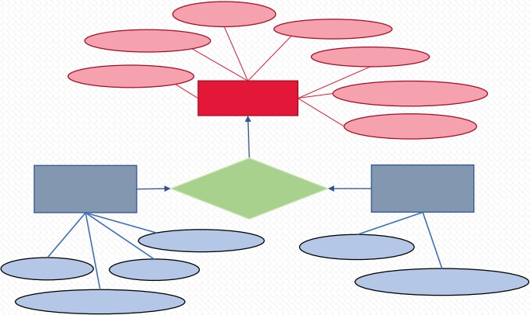
DATA DESCRIPTION
Information of 10,000 clients of a bank with no missing data
Columns:
Surname
● RowNumber: Row Numbers from 1 to 10000
Geography
CustomerId
● CustomerId: Unique Ids for bank customer identification ● Surname: Customer's last name
Gender
Age
Customer
● Geography: The country from which the customer belongs ● Gender: Male or Female
EstimateSalary
● Age: Age of the customer
CreditScore
● EstimatedSalary: Estimated salary of the customer in Dollars
● CreditScore: Credit score of the customer
Account
Status
Customer
Customer
Products
● Tenure: Number of years for which the customer has been with the bank
● Balance: Bank balance of the customer
Account
● NumOfProducts: Number of bank products the customer is utilizing
● HasCrCard: Binary Flag for whether the customer holds a credit card with the bank or not
Tenure
HasCrCard
● IsActiveMember: Binary Flag for whether the customer is an active member with
the bank or not
Exited
Balance
● Exited: Binary flag 1 if the customer closed account with bank and 0 if the
NumOfProducts
customer is retained
IsActiveMember
7/13/2019
4

Slide 5
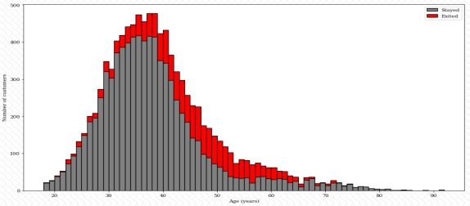
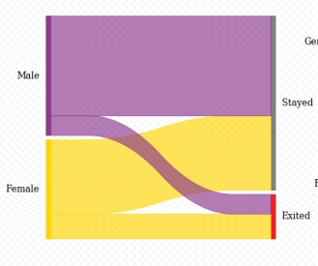
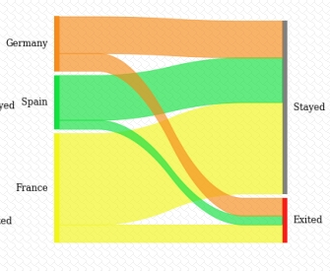
DATA DESCRIPTION
79.6% 20.4%
Stayed Exited
1. As for gender, women are lower in number than the men, but have a higher rate to close the account.
2. There is a higher rate of exited clients in Germany (32%, which is about 2x higher), and lower in Spain and France (around 16% each).
3. On age, customer bellow 40 and above 65 years old have a tendency to keep their account.
7/13/2019

Slide 6
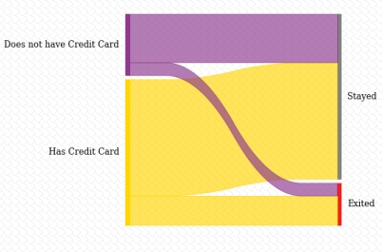
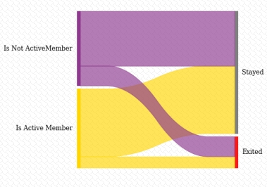
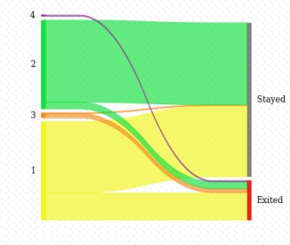
DATA DESCRIPTION
4. Has or not credit card does not impact on the decision to stay in the bank (both groups has 20% of exited customers)
5. Non active members tend to discontinue their services with a bank compared with the active clients (27% vs 14%).
6. The dataset has 96% of clients with 1 or 2 product, and customers with 1 product only have a higher rate to close the account than those with 2 products (around 3x higher).
7/13/2019

Slide 7
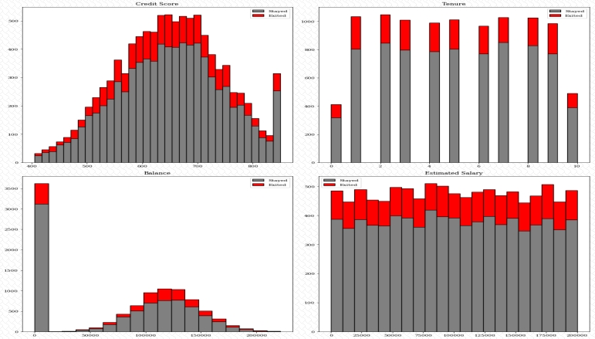
DATA DESCRIPTION
6. Estimated Salary does not seem to affect the churn rate
7. The other metrics is hard to say
7/13/2019

Slide 8
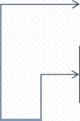







Prediction Methodologies
As we have imbalanced dataset, we will test the 5 models using two different
strategies:
1. Complete training set (80% of the dataset)
2. Balanced training where we randomly select from the
complete training set the same number of Stayed and Exited customers.
Complete Dataset
(n=10,000)
One-Hot encoding
Categorical
Attributes
Logistic
Regression
(Grid Search with
CV)
LR
Quality
Metrics
Drop irrelevant
Attributes
Multi Layers
Perceptron
(Grid Search with CV)
MLP
Quality
Metrics
Create
Train set
and
Test set
GB: Gradient
Boosting
Classifier
(Grid Search with CV)
Test set
Feature
Scaling
GB
Quality
Train set
Feature
Scaling
Model
Comparis
on Table
Selected
Model
Metrics
XGBoost
Quality
Metrics
XGBoost
LightGBM
Quality
Metrics
LightGBM
7/13/2019
8

Slide 9
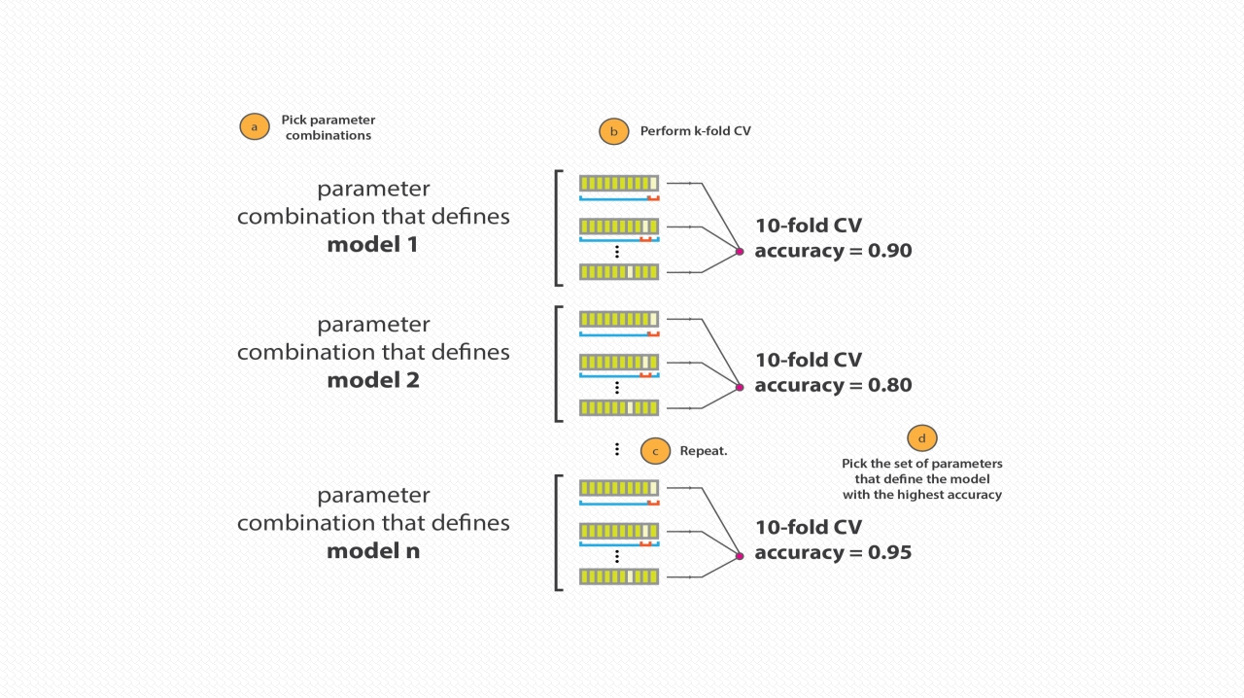
sklearn: GridSearchCV
Image Source
7/13/2019
9

Slide 10
sklearn: Logistic Regression
• Fast
• No tuning required
Pros
• Highly interpretable
• Well-understood
• Unlikely to produce the best predictive accuracy
• Presumes a linear relationship between the features and response
Cons
• If the relationship is highly non-linear as with many scenarios, linear relationship will not effectively model the relationship and its prediction would not be accurate
7/13/2019
10

Slide 11
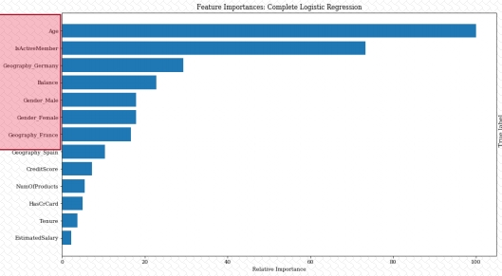
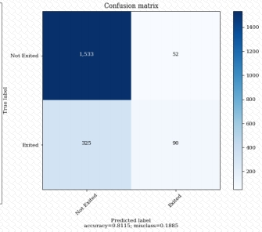
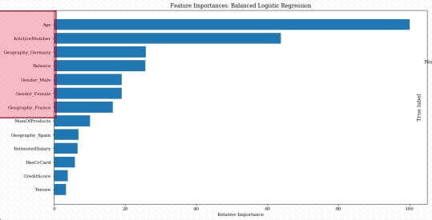
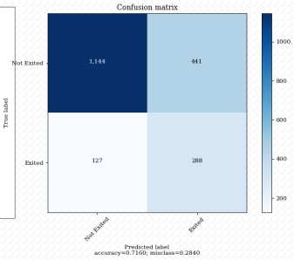
sklearn: Logistic Regression
Accuracy:0.8115
Balanced Accuracy: 0.592
Recall 1: 0.217
Accuracy: 0.716
Balanced Accuracy: 0.708
Recall 1: 0.694
The top Feature
importance is more
related to demographic
information
7/13/2019
11

Slide 12
sklearn: MLP – Multi-Layers Perceptron
• Can learn and model complex and non-linear relationships.
Pros
• Can generalize well on unseen data. They can work with incomplete data.
• MLP are fault tolerant. An error in one node cannot affect the entire network.
• They require powerful hardware specifications.
Cons
• Difficult to understand how the prediction was arrived at.
• There is no defined guidelines in determining the suitable network structure to use and it all depends on the experience and trial and error.
7/13/2019
12

Slide 13
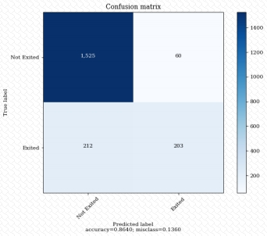
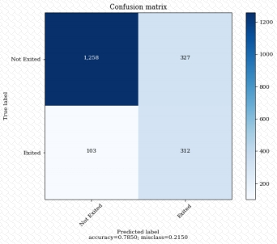
sklearn: MLP – Multi-Layers Perceptron
Accuracy: 0.864
Balanced Accuracy: 0.726
Recall 1: 0.489
Accuracy: 0.785
Balanced Accuracy: 0.773
Recall 1: 0.752
7/13/2019
13

Slide 14
sklearn: GB - Gradient Boosting Classifier
• Often provides predictive accuracy that cannot be beat.
• Lots of flexibility - can optimize on different loss functions and provides several hyperparameter
Pros
tuning options that make the function fit very flexible.
• No data pre-processing required - often works great with categorical and numerical values as is.
• Handles missing data - imputation not required.
• GBMs will continue improving to minimize all errors. This can overemphasize outliers and cause overfitting. Must use cross-validation to neutralize.
• Computationally expensive - GBMs often require many trees (>1000) which can be time and memory exhaustive.
Cons
• The high flexibility results in many parameters that interact and influence heavily the behavior of the approach (number of iterations, tree depth, regularization parameters, etc.). This requires a large grid search during tuning.
• Less interpretable although this is easily addressed with various tools (variable importance, partial dependence plots, etc.).
7/13/2019
14

Slide 15
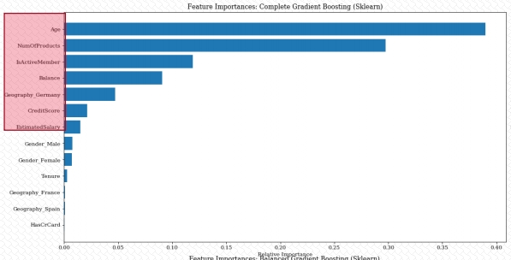

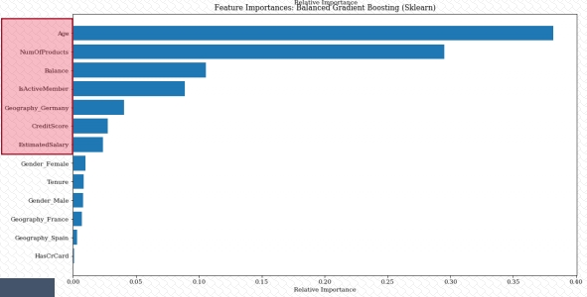

sklearn: GB - Gradient Boosting Classifier
Accuracy: 0.860
Balanced Accuracy: 0.715
Recall 1: 0.467
Accuracy: 0.799
Balanced Accuracy: 0.794
Recall 1: 0.786
The top Feature
importance is more
related to the customer
account updates
7/13/2019
15

Slide 16
XGBoost: XGB – Extreme Gradient Boosting
• Fast
• Produces highly accurate models as a result of multiple decision trees & regularization
Pros
• Very good model training performance
• Users can specify custom optimization objectives and evaluation criteria
• Can run on the GPU
• XGBoost GPU implementation does not scale well to large datasets and ran out of memory often
Cons
• Usually slower than the LightGBM
7/13/2019
16

Slide 17
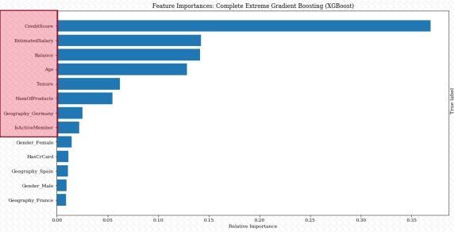

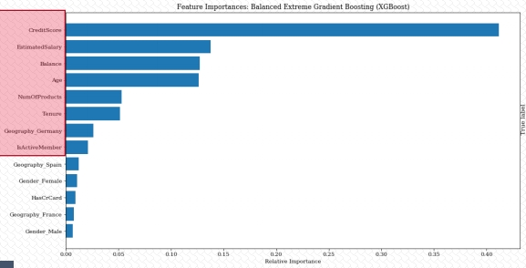
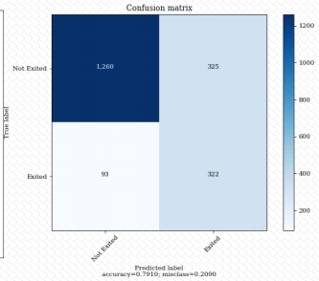
XGBoost: XGB – Extreme Gradient Boosting
Accuracy: 0.864
Balanced Accuracy: 0.723
Recall 1: 0.482
Accuracy: 0.791
Balanced Accuracy: 0.785
Recall 1: 0.776
The top Feature
importance is more
related to the customer
account updates
7/13/2019
17

Slide 18
LightGBM: Light Gradient Boosting Machine
• Fast and accurate
Pros
• Can handle categorical features by taking the input of feature names
• XGBoost and LightGBM achieve similar accuracy metrics
• Also runs on GPU
• LightGBM has lower training time than XGBoost
Cons
• They require powerful hardware specifications.
• Difficult to understand how the prediction was arrived at.
• There is no defined guidelines in determining the suitable network structure to use and it all depends on the experience and trial and error.
7/13/2019
18

Slide 19
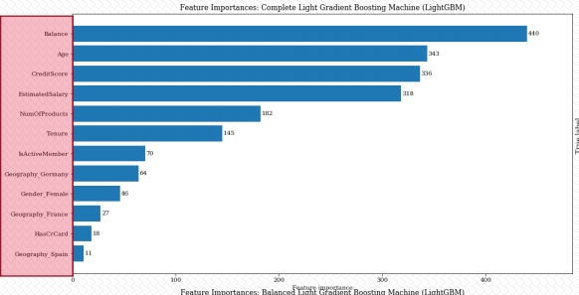
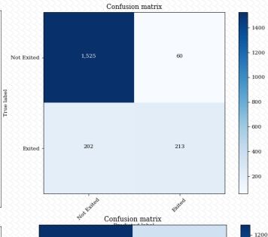
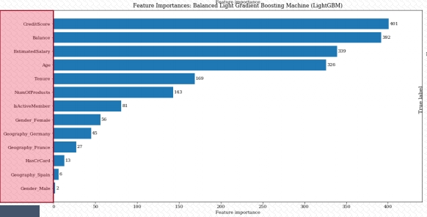

LightGBM: Light Gradient Boosting Machine
Accuracy: 0.869
Balanced Accuracy: 0.738
Recall 1: 0.513
Accuracy: 0.795
Balanced Accuracy: 0.790
Recall 1: 0.783
The top Feature
importance is more
related to the customer
account updates
7/13/2019
19

Slide 20
MODELS COMPARISONS
Model | Balanced | Accuracy | Balanced_Accuracy | AUC | precision_0 | recall_0 | f1-score_0 | precision_1 | recall_1 | f1-score_1
Logistic Regression | no | 0.812 | 0.592 | 0.778 | 0.825 | 0.967 | 0.891 | 0.634 | 0.217 | 0.323
Multi-Layer Perceptron (MLP) | no | 0.864 | 0.726 | 0.871 | 0.878 | 0.962 | 0.918 | 0.772 | 0.489 | 0.599
Gradient Boosting (Sklearn) | no | 0.860 | 0.715 | 0.878 | 0.873 | 0.963 | 0.916 | 0.767 | 0.467 | 0.581
Gradient Boosting (XGBoost) | no | 0.864 | 0.723 | 0.875 | 0.877 | 0.963 | 0.918 | 0.775 | 0.482 | 0.594
Gradient Boosting (LightGBM) | no | 0.869 | 0.738 | 0.881 | 0.883 | 0.962 | 0.921 | 0.780 | 0.513 | 0.619
Logistic Regression | yes | 0.716 | 0.708 | 0.780 | 0.900 | 0.722 | 0.801 | 0.395 | 0.694 | 0.503
Multi-Layer Perceptron (MLP) | yes | 0.785 | 0.773 | 0.870 | 0.924 | 0.794 | 0.854 | 0.488 | 0.752 | 0.592
Gradient Boosting (Sklearn) | yes | 0.799 | 0.794 | 0.878 | 0.935 | 0.803 | 0.864 | 0.510 | 0.786 | 0.619
Gradient Boosting (XGBoost) | yes | 0.791 | 0.785 | 0.869 | 0.931 | 0.795 | 0.858 | 0.498 | 0.776 | 0.606
Gradient Boosting (LightGBM) | yes | 0.795 | 0.790 | 0.872 | 0.934 | 0.797 | 0.860 | 0.503 | 0.783 | 0.613
• All models perform well when looking the pure accuracy score.
• For all the models, the pure accuracy decreased, compared to the unbalanced training set
Unbalanced
• For the balanced accuracy, LR does not perform well, and the other models had the score from 72% to 74%
Balanced
• The balanced accuracy increased to up to 79% (LightGBM) and LR was the model that improved more.
Training set
Training set
• The LightGBM performs slightly better also when we looking at the recall of the exited clients
• The tree based classifier models worked better in all the evaluated metrics.
By looking at the score metrics and speed performance, the model I would chose is the Gradient Boosting Classifier from the
LightGBM package. But the XGBoost is close behind.
7/13/2019
20

Slide 21
FUTURE WORK
• Do some feature transformations (feature engineering)
• Tuning better the models, most specifically the MLP classifier
• Try other models as SVM –Support Vector Machine
• Try other packages as Keras and Pytorch to implement MLP classifier
7/13/2019
21

Slide 22


THANK YOU

